Slide 1
[ 3rd week Report ]
Researching Project
“ Soil Ph meter Design ”
Lecturer: Hel Chanthan
By: Nhim ChanRengSey
2019-2020

Slide 2
Outline
Filter Design:
Low Pass Filter
High Pass Filter
Band Pass Filter
Band Stop Filter
Missing and Difficulty

Slide 3
Filter design
Why do we have to built filter?
Because we need to remove noise from our signal to micro-controller.( remove power of noise)
How can filter help in our circuit?
If we use filter in our circuit, we can control or limit range of frequency that we need to give to micro-controller.
(limit Bandwidth)
How can we apply filter to our circuit?
We need check noise in our sensor then we built filter to cut noise.
How can we built filter for our sensor?
We have to know bandwidth for our sensor then we can built filter for it.
Page: 01

Slide 4
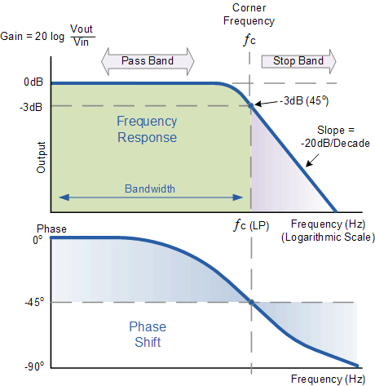
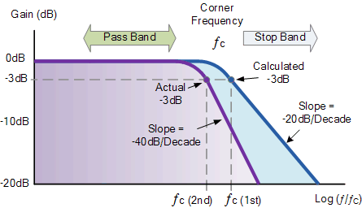
Low pass filter
We use Low Pass Filter to remove high frequency (noise) from signal.
Input1 and Input2
LOW PASS FILTER
Input1
Input1 (low frequency)
Input2(High frequency)
Low pass filter:
Signal 11Mhz and 5dB
Cut off frequency 10Mhz at -3dB
Can that signal throw our filter?
Filter design: Active and Passive.
How to use filter link:
https://tools.analog.com/en/filterwizard/
Page: 02

Slide 5
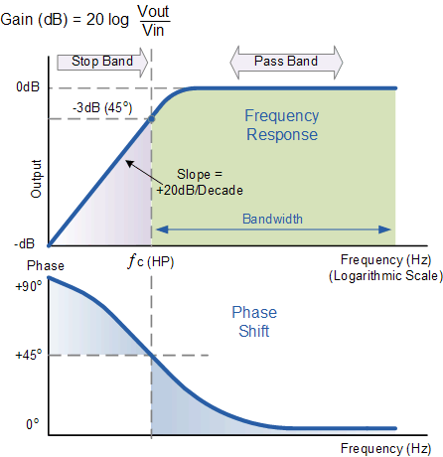
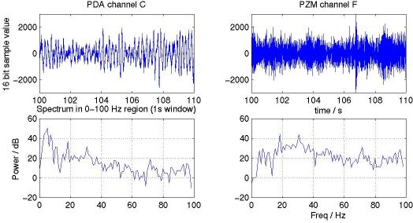
High pass filter
We use High Pass Filter to remove low frequency (noise) from signal.
Page: 03

Slide 6
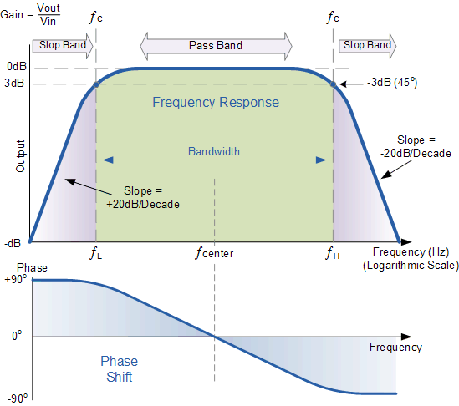
Band pass filter
We use Band Pass Filter to limit range of frequency that we need for use from signal.
I mean:
We can cut low and high frequency noise by use band pass filter.
Page: 04

Slide 7
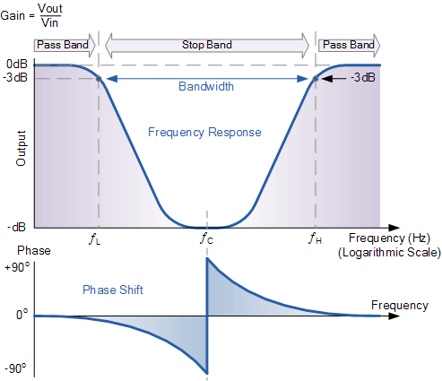
Band stop filter
We use Band Stop Filter to limit range of frequency that we don’t need for use from signal. (opposite of BPF)
Page: 05

Slide 8
Difficulty and Missing
Difficulty :
Hard to understand.
Hard to research sample.
I have learned more about it but I still don’t understand to use it.(take long time)
Missing:
Lately work
Page: 06

Slide 9
Planning for 1st month
Week | Monday | Tuesday | Wednesday | Thursday | Friday | Goal
1st Week | Research | Meeting | Learn Amplifier | Presentation | Learn Filter | Learn Filter
2nd Week |  |  | REST DAYS
3rd Week | Learn Filter | Learn Filter | Learn Filter | Learn Filter | Learn Filter | Learn Filter
4th Week | Learn Amplifier | Learn Amp Meeting | Learn Amplifier | Presentation Learn Amp | Learn Amplifier | Learn Amplifier
Start : 10/08/2020
Page: 07

Slide 10
THANK YOU

